Slide 1
Methamphetamine
Richard Welter

Slide 2
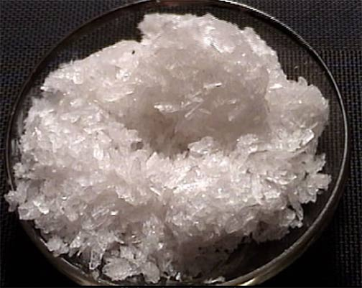
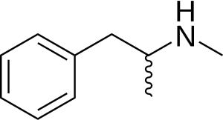
What is Methamphetamine?
Known as meth, ice, crank, crystal, etc.
Stimulant (upper)
Can be swallowed, consumed, injected, and/or snorted
Schedule II drug under Controlled Substance Act of 1970

Slide 3
History
Synthesized from ephedrine in Japan by Nagayoshi Nagai in 1893.
Primarily military use, especially during World War II for endurance and alertness.
Became an epidemic in the United States in the 1940-1950’s when amphetamines began being prescribed.
Initially used as a way to lose weight.
Halted entirely in 1970 under the Controlled Substance Act.
Currently prescribed under Desoxyn (obesity and sleep).

Slide 4
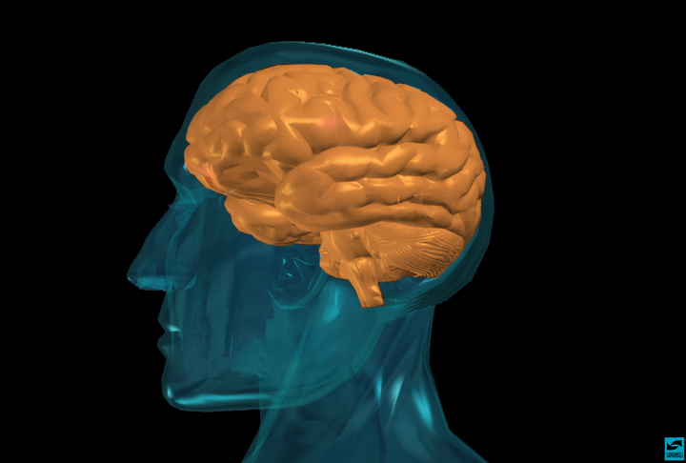
Effects: Mind

Slide 5
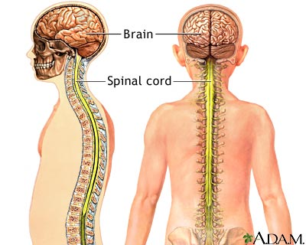
Meth contains Central Nervous System (CNS) properties
Euphoria
Paranoia
Anxiety
Aggression
Harms Dopamine

Slide 6
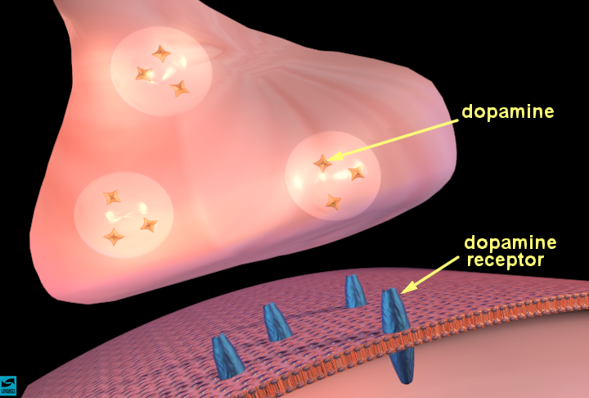
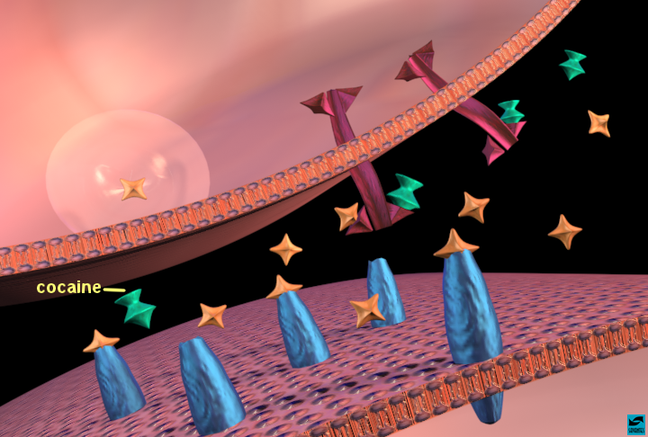
Dopamine
Processed in amygdala
Neurotransmitter that is responsible for movement, emotional response, and pleasure. It’s the “more” and cravings we’ve discussed in class.
Meth

Slide 7
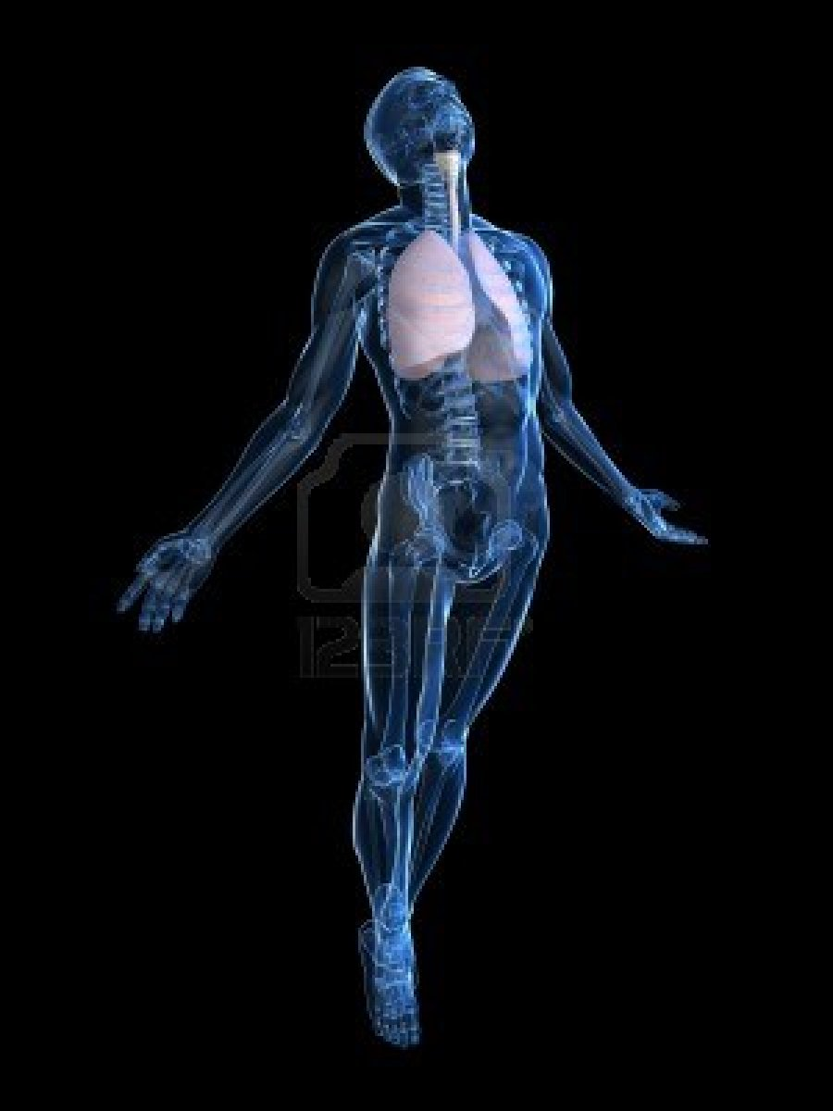
Effects: Body

Slide 8
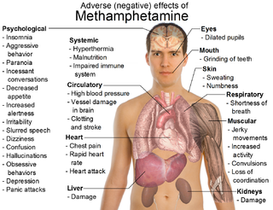
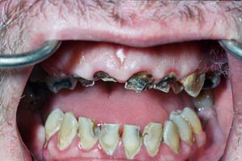
Decreased appetite
Irregular heartbeat
Increased blood pressure
Increased physical activity
Awake
Dental problems (ie. Decay)

Slide 9
Pop Culture and Methamphetamine

Slide 10
Spun (2002)
Rock Bottom: Gay Men & Meth (2006)
Breaking Bad (2008)
Intervention

Slide 11
Work Cited
http://www.justice.gov/dea/druginfo/drug_data_sheets/Methamphetamine.pdf
http://methoide.fcm.arizona.edu/infocenter/index.cfm?stid=164
http://www.utexas.edu/research/asrec/dopamine.html
http://www.crystalmeth.com/articles_popular_methamphetamine_in_popular_culture.php

